Slide 1
Chapter 1: Fundamentals of Management Ref: Organization And Management - Agarwal

Slide 2
Content
Concept of Management
Management Functions

Slide 3
Introduction
“Management is the process of designing and maintaining the environment in which individual work together in group, and efficiently and effectively accomplish the selected aim” -Basic definition
“Art of getting things done through people” -Mary Parker Follett.

Slide 4
Definition
“Management is the art of “knowing what you want to do” and then seeing that it is done in the best and cheapest way. ……F.W.Taylor
Management as a process “consisting of planning, organizing, actuating and controlling, performed to determine and accomplish the objective by the use of people and resources.”
……George R. Terry

Slide 5
In this definition,
Planning means Plan in advance.
Organizing means coordination between human resources and material resources.
Actuating means motivation and giving direction to subordinate.
Controlling means to ensure about implementation of plan without deviation.
Thus this definition tells that management is act of achieving the organization objectives.

Slide 6
Functions of Management 1. Planning
It is a process of deciding the business objectives and charting out the plan/ method for achieving the same. This includes
Determination of what is to be done, how, and where it is to be done, who will do it and how result are to be evaluated.
Determination of short and long range objectives.
Development of strategies and courses of action to be followed
Formulation of policies, procedures and rules for implementing strategies and plans.

Slide 7
2. Organizing
To organize a business is to provide it with everything useful to its functioning i.e. personnel, raw materials, machineries, capital etc.
Once objectives are established, manager has to develop plan to achieve them with help of human resources as well as material resources.
Assignment of jobs to employees.
Delegation of authority.

Slide 8
3. Staffing
Manpower planning: determination of no. of and the kind of personnel required.
Recruitments of suitable no. of employees
Selection of most suitable employees
Placement, induction and orientation
Transfer, promotions & terminations
Trainings and developments

Slide 9
4. Directing
Directing involves communication, leadership and motivation.
Communication is the process of passing the information and understanding it from one person to other person.
Leadership is the function whereby the person or manager guides and influences the work of his subordinates.
Motivation is to motivate the employee to give their best to the organization.

Slide 10
5. Coordinating
Clear definition of authority-responsibility relationships
Unity of direction
Unity of command
Effective communication
Effective leadership

Slide 11
6. Controlling
The controlling involves-
1. Establishing standards of performance.
2. Measuring current performance and comparing it against the established standard.
3.Taking corrective action that does not meet the standard.

Slide 12
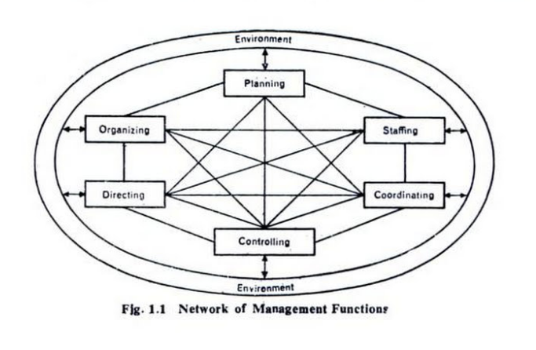
Network of Management Functions

Slide 13
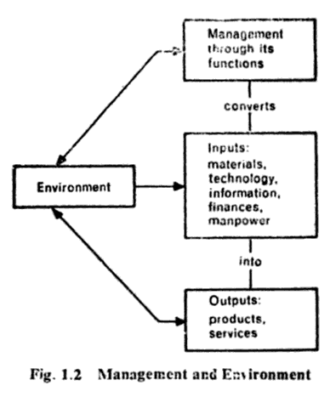
Environment Makes Management A Dynamic Process

Slide 14
Management And Administration
On the Basis of Functions: -
 | Management | Administration
Meaning | Management is an art of getting things done through others by directing their efforts towards achievement of pre-determined goals. | It is concerned with formulation of broad objectives, plans & policies.
Nature | Management is an executing function. | Administration is a decision-making function.
Process | Management decides who should do it & how should he do it. | Administration decides what is to be done & when it is to be done.
Function | Management is a doing function because managers get work done under their supervision. | Administration is a thinking function because plans & policies are determined under it.
Skills | Technical and Human skills | Conceptual and Human skills
Level | Middle & lower level function | Top level function

Slide 15
Management And Administration
On the Basis of Usage: -
Basis | Management | Administration
Applicability | It is applicable to business concerns i.e. profit-making organization. | It is applicable to business and non-business concerns i.e. clubs, schools, hospitals etc.
Influence | The management decisions are influenced by the values, opinions, beliefs & decisions of the managers. | The administration is influenced by public opinion, govt. policies, religious organizations, customs etc.
Status | Management constitutes the employees of the organization who are paid remuneration (in the form of salaries & wages). | Administration represents owners of the enterprise who earn return on their capital invested & profits in the form of dividend.

Slide 16
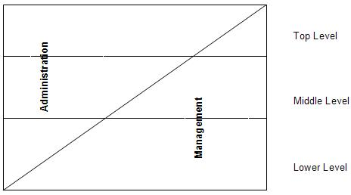
Management And Administration
The Figure above clearly shows the degree of administration and management performed by the different levels of management.

Slide 17
Managerial Skills Ref: Industrial Engineering and Management – O. P. Khanna

Slide 18
Levels of Management
Top Management President, CEO, Executive Vice Presidents
Middle Management Plant Managers, Division Managers, Department Managers
First-Line Management Foreman, Supervisors, Office Managers
Non- Managerial Employees

Slide 19
Importance of Management Functions to Managers in Each Level
Most Important
Organizing
Controlling
Organizing
Controlling
Organizing
Controlling
Directing
Planning
Directing
Planning
Directing
Planning
Staffing
Staffing
Staffing
Least Important
Top Managers
Middle Managers
First-Line Managers

Slide 20
Managerial Skills
Technical Skill
Conceptual Skills
Human Relation Skills
The proficiency in handling
Methods
Processes &
Techniques of a particular kind of business
Decision Making Skills
Organizational Skills
Communicating Skills
Motivating Skills
Leadership Skills

Slide 21
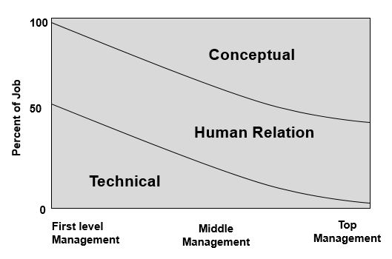
Managerial Skills
Fig: Managerial Skills

Slide 22
Managerial Skills
Technical Skills
The proficiency in handling
Methods
Processes &
Techniques of a particular kind of business
Essential for lower level management

Slide 23
Managerial Skills
2. Conceptual Skills
The ability to see organization as a whole, to recognize inter-relationships among different functions, to guide effectively organizational efforts.
Essential for top executive management
Difficult to learn than technical skills.
Decision Making Skills
Requires mental stability and presence of mind.
Organizational Skills
Placement of right people for right job

Slide 24
Managerial Skills
3. Human Relation Skills
The ability to select and fix the work effectively with others and build cooperative work groups to achieve organizational goals.
Communicating Skills
Motivating Skills
Leadership Skills

Slide 25
Managerial Skills
a. Communicating Skills
ability to pass information to others.
b. Motivating Skills
ability to inspire people to do what the manager want them to do. (+VE/-VE).
c. Leadership Skills
ability to inspire confidence and trust in the subordinates to have maximum cooperation for getting the work done.

Slide 26
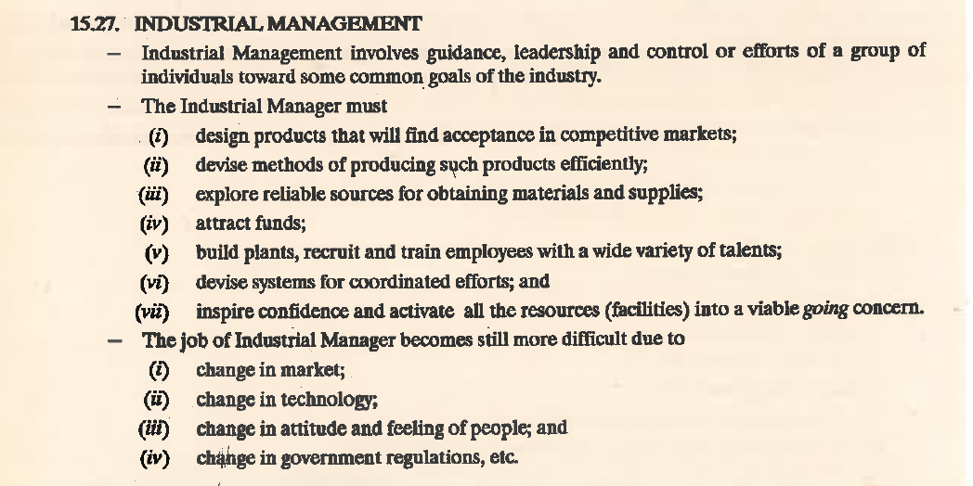

Slide 27
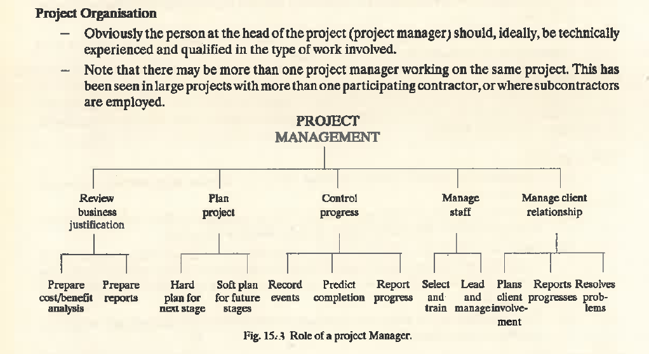

Slide 28
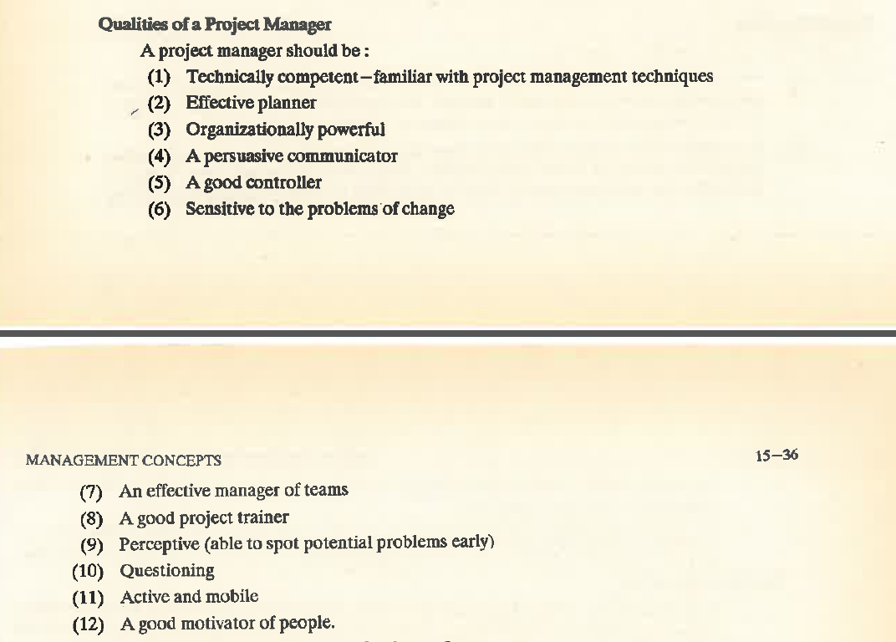

Slide 29
Thank You

